Slide 1
Java EE
Inter-servlet communication
Servlet Redirection (sendRedirect() method)
Request Dispatcher
include() and forward() methods
Session Handling

Slide 2
Inter-Servlet Communication
Inter-Servlet Communication is possible through:
Request Dispatcher - direct invocation of a web resource calling include() or forward() methods of RequestDispatcher
Servlet Redirection -
indirect invocation of web resource using sendRedirect() method of
HttpServletResponse
RequestDispatcher’s include()/forward() method transfers the control of the request to another servlet or jsp without informing anything about this request dispatch to the client browser. Therefore client browser has no knowledge about the returned resource is from another servlet/jsp. Only one request/response cycle is required.
sendRedirect ()method stops further processing of the request and sends http status code "302" and URL of the
location to be redirected to the client browser in the response header.
Client browser looks at http status 302 and then it knows that it should send a new request to the url in "Location“ specified in the http header which is set by server and Client browser sends a new request to the new URL and it will be processed by the server as another normal request.
In this case, Two request/response cycles are required.

Slide 3
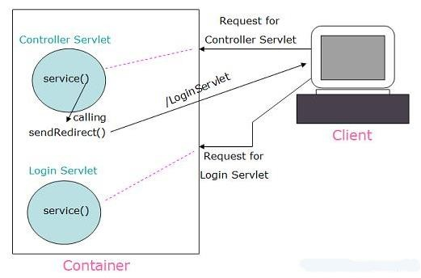
SendRedirect Example
@WebServlet("/Controller")
public class ControllerServlet extends HttpServlet {
…………….
// read parameters if(valid_credentials){
response.sendRedirect("LoginServlet");
}
else{ response.sendError(HttpServletResponse.SC_NOT_FOUND, "Invalid Credentials"); }
…….
}
Observe URI
@WebServlet("/LoginServlet")
public class LoginServlet extends HttpServlet { @Override
protected void service(HttpServletRequest request, HttpServletResponse response)
throws ServletException, IOException{ PrintWriter out = response.getWriter(); out.println("Welcome to Web Application");
}
}
login.html
<form action= "Controller" method="POST">
<p>Enter user name <input type="text"
name="username" size="20"></p>
<p>Enter password <input type="password" name= " password" size="20"></p>
<p><input type="submit" value="Submit"> </p>
</form>

Slide 4
RequestDispatcher
The javax.servlet.RequestDispatcher interface of Java Servlet API provides methods to dispatch the request
from one Web component to another Web resource in the context.
Dispatching the Request:
Getting a RequestDispatcher object
Using include() or forward() methods of RequestDispatcher
Getting a RequestDispatcher object:
The RequestDispatcher object can be obtained by using the following methods:
The getRequestDispatcher(java.lang.String path) method of ServletContext
The getRequestDispatcher(java.lang.String path) method of ServletRequest
RequestDispatcher requestDispatcher = getServletContext().getRequestDispatcher("url");
or
RequestDispatcher requestDispatcher = request.getRequestDispatcher("url");
Dispatching request/response objects:
requestDispatcher. include(request,response);
or
requestDispatcher. forward(request,response);

Slide 5
Relative Path Vs Absolute Path
The getRequestDispatcher() method of ServletContext
The getRequestDispatcher() method of ServletContext takes a String argument describing the path to
locate the resource to which the request is to be dispatched.
When this method is called , the container locates the resource with the given path where path should start with /
The getRequestDispatcher() method of ServletRequest
The getRequestDispatcher() method of ServletRequest takes a String argument describing the path
relative to the current request.
The Servlet container uses the information in the request object to build a complete path and locates the resource using the path.
Note : ServletRequest.getRequestDispatcher takes a relative URL while
ServletContext.getRequestDispatcher takes absolute path.

Slide 6
The getRequestDispatcher() Methods
Let us consider an example to demonstrate the use of the getrequestDispatcher() method in different cases.
Servlet Name | URL | URL Pattern
Servlet1 | http://localhost:8080/mycntxt/myser1 | /myser1
Servlet2 | http://localhost:8080/mycntxt/myser2 | /myser2
Servlet3 | http://localhost:8080/mycntxt/myservlets/myser3 | /myservlets/myser3
Servlet4 | http://localhost:8080/mycntxt/myservlets/myser4 | /myservlets/myser4
Now, to forward the request from the Servlet1 to Servlet4, we can call getRequestDispatcher() method using
the following methods:
ServletContext context = getServletContext();
RequestDispatcher requestDispatcher= context.getRequestDispatcher("/myservlets/myser4"); or
RequestDispatcher requestDispatcher = request.getRequestDispatcher("myservlets/myser4");
How do we forward the request from the Servlet4 to Servlet1 using both the methods ?

Slide 7
SendRedirect method Vs RequestDispatcher
Replace the following statement in the ControllerServlet
response.sendRedirect("LoginServlet");
with the following statements
RequestDispatcher requestDispatcher= getServletContext().getRequestDispatcher("/LoginServlet"); requestDispatcher.forward(request, response);
Now observe the URI

Slide 8
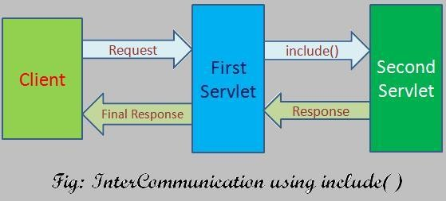
include() method
An included web component has access to the request object but is limited in what it can do with the response object.
It can write to the body of the response.
It cannot set headers or call any method, such as setCookie(), that affects the headers of the response.
The response generated from the calling servlet is also included to the final response.
The method prototype for include() method is as follows:
public void include(ServletRequest request, ServletResponse response) throws ServletException, java.io.IOException

Slide 9
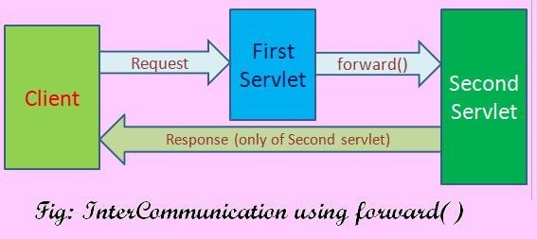
forward() Method
forward(): The forward() method of RequestDispatcher interface is responsible for simply forwarding the
request from one resource to another.
The response generated from the calling servlet is not added to the final response.
The forward() method allows only the target Servlet to set the response headers.
public void forward(ServletRequest request, ServletResponse response) throws ServletException, java.io.IOException

Slide 10
Comparing include() and forward() Methods
The forward() method allows the target Servlet to set the response headers. However, it cannot be done with the include() method.
In the forward() method, the source Servlet cannot generate the response content, but it can be done
with the include() method.
Note : In the case of the forward() method, after the target Servlet completes the execution of its service() method and before the control is given back to the source Servlet, the RequestDispatcher object closes the response stream.
Due to this reason, the source servlet data is not added to the response buffer.

Slide 11
Java EE
Sharing data between web components
Request and Application object attributes
Session Handling

Slide 12
Using Scope Objects
There are four scope objects in servlets & JSPs which enables sharing information between web components.
Collaborating web components share information by means of objects that are maintained as
attributes of four scope objects.
We can access these attributes by using getAttribute() and setAttribute() methods of the class
representing the scope.
The scope objects and their corresponding Java classes are listed below:
Scope Object | Class | Accessible from
Web context/ application | javax.servlet.ServletContext | Web components within a web context/web application.
Session | javax.servlet.http.HttpSession | Web components handling a request that belongs to the session.
Request | Subtype of javax.servlet.ServletRequest | Web components handling the request.
Page | javax.servlet.jsp.PageContext | The JSP page that creates the object.

Slide 13
Object Visibility
Included or forwarded objects do not share Java variables with the originating resource, but they do share attributes.
Thus if you include the following code
object.setAttribute("attributeName", "attributeValue");
Within the doGet method of another web component, we can retrieve the value of that attribute with a call to object.getAttribute("username");
Note: JSP supports the equivalent action via the jsp:include, jsp:forward, and jsp:param.

Slide 14
Request Object Attributes
The Servlet container supports an ability to dispatch requests from one Servlet to another within the context. This is required if you want to make some information available from the source Servlet to the target Servlet or vice-versa.
The javax.servlet.ServletRequest object manages the data within the request scope to meet this
requirement.
The ServletRequest object has methods to set and get name-value pairs into the request scope. Such name-value pairs are called as attributes.
Methods:
void setAttribute(String,Object)- Sets an attribute with the current request. If the given String name is already bound with an object, it is replaced by the new object.
Object getAttribute(String) – Returns the value of an attribute located with the given name or returns null value if an attribute with the given name is not found.
Enumeration getAttributeNames()-Returns all the attribute names in the current request as an Enumeration of String or returns empty Enumeration, if there are no attribute in the request.
void removeAttribute(String) – Removes an attribute by the given name from the request.

Slide 15
SESSION HANDLING

Slide 16
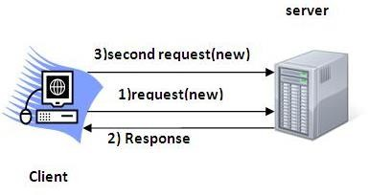
WHAT IS SESSION HANDLING
The protocol used for communication between a browser and the Web server is generally HTTP which is
a stateless protocol.
Each time user sends a request to the web server, the server treats the request as a new request. This
means that the Web server does not remember the previous interaction with the browser(client).
Session tracking is a way to maintain state of a HTTP client (browser) between multiple request-response cycles between the browser and the Server.
Online Web Applications: Reservation Systems, Shopping portals, Bank Transactions etc.

Slide 17
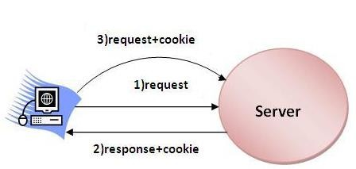
COOKIES
There are three primary ways of implementing session handling in your applications:
1. Session handling using cookies— mostly used technology for session tracking.
Cookie is a small text file that contains information in form of key value pairs, sent by the server to the browser. The browser saves the cookie in the client’s machine.
So, whenever the browser sends a request to the same server, it sends the cookie along with it. The server can identify the client through this cookie.
Disadvantage:
Users can opt to disable cookies using their browser preferences. In such case, the browser will not save the cookie at client’s machine and session tracking fails.
There are two types of cookies:
Session cookies - are temporary cookie files, which are erased when
we close the browser.
Persistent cookies – These files stay in one of our browser's subfolders until we delete them manually or the browser deletes them based on the duration period contained within the persistent cookie's file.

Slide 18
Sending Cookies to the Client
Create a Cookie object.
Call the Cookie constructor with a cookie name and a cookie value, both of which are Strings.
Cookie cookie = new Cookie("name", "value");
Ex. Cookie cookie_name = new Cookie("username“, "Smith");
Add the cookie to the Set-Cookie response header by means of the addCookie method of
HttpServletResponse.
response.addCookie(cookie_name);
Ex. response.addCookie(cookie);
Note : If you forget this step, no cookie is sent to the browser!
Call request.getCookies() method that returns an array of Cookie objects in the Servlet.
Loop down the array, calling getName() & getValue() on each entry.

Slide 19
Setting age limit for a cookie object
To set the age limit for a cookie object
public void setMaxAge(int expiry)
Sets the maximum age of the cookie in seconds.
A positive value indicates that the cookie will expire after that many seconds have passed.
A negative value means that the cookie is not stored persistently and will be deleted when
the Web browser exits(session cookie).
A zero value causes the cookie to be deleted.
Note: If you don't set this, the cookie will last only for the current session.

Slide 20
URL RE-WRITING
2. URL Rewriting
Original URL: http://server:port/servlet/ServletName
Rewritten URL: http://server:port/servlet/ServletName?jsessionid=DA32242SSGE2
When a request is made, additional parameter is appended to the url. Generally the added
parameter will be jsessionid or sometimes the userid.
Disadvantage:
We have to be careful that every URL returned to the user (even via indirect means like Location fields in server redirects) has the extra information appended.
And, if the user leaves the session and comes back via a bookmark or a hyperlink, the session information can be lost.

Slide 21
Hidden form fields
3. Hidden form fields.
HTML forms have an entry that looks like the following:
<INPUT TYPE="HIDDEN" NAME="session" VALUE="...">.
This means that, when the form is submitted, the specified name and value are included in
the GET or POST data. This can be used to store information about the session.
Disadvantage
Works only if every page is dynamically generated,

Slide 22
HttpSession
Session Handling: HttpSession API
State maintenance between the client browser and the servlet is done by the server's setting a cookie
in the client browser.
But unlike the plain cookie method of session handling, where all the session data is stored in the cookie as name-value strings in the client’s machine, the onus of maintaining the session is undertaken by the Web Server.
Here the web server creates an session object with a unique identifier and stores the session information in it and sends only the session-id to the client and the browser stores the session-id in form of a cookie in the client’s machine.
Since this data is stored on the server side and only the identifier is passed back and forth between the client browser and the web server as a cookie, this method is an example of server-side session
handling.
The server maintains a mapping of session identifiers generated for different clients and the data stored for each session.

Slide 23
HttpSession
When the Servlet container creates a session object( by using getSession() method), it creates a unique
identity and sets it into the cookie with the name jsessionid.
However, in some situations, a browser may not accept cookies, which means that session tracking
with cookies is not possible.
In such cases, session identity is appended to the URLs by using URL rewriting.
Most Servlet containers use URL rewriting when a session is new, even if the browser accepts cookies, because the server cannot determine during the first visit of a session, whether the browser accepts cookies or not.
If the cookies are not disabled by the browser, from the next trip onwards cookie which contains the
session-id travels between the server and the client to maintain the state.
In case browser has disabled cookies, then URL rewriting technique is implemented to maintain the
state between the server and the client.

Slide 24
HttpSession
Using sessions in servlet is quite straightforward, and involves :
Looking up the session object associated with the current request,
creating a new session object when necessary, looking up information associated with a session,
storing information in a session, and
discarding completed or abandoned sessions.

Slide 25
Creating a session object
getSession() or getSession(true) methods of HttpServletRequest .
When the above methods are called, the Web Container tries to locate the session object and returns it. If unable to locate the session object , it creates a new session and associates it with the client request.
The above methods perform the following operation when an session object is created:
Creates a new session object provided there is no existing session object associated with the request.
Prepares a unique identity for the new session
Sets this identity into a cookie with the name jsessionid
Returns a session object
getSession(false)
The web container tries to locate and if found returns the session object, if web container is unable to
locate the session, it returns null.

Slide 26
Storing information in a session
Session objects have a built-in data structure that allows you to store any number of key-value pairs.
public void setAttribute(String name, Object value)
where name identifies the object that is bound to the session.
So the above method binds an object to this session, using the name specified.
Note: The setAttribute() method replaces the attribute value if the attribute already exists in the
session, i.e. if the given name is already mapped to a value.
In this case, If the given value is null then this method acts similar to removeAttribute() method.
Note: If the object bound to an session object is an HashMap or Hashtable, then it can be used to hold the
data in form of key-value pairs between the requests for the same user and session.
Retrieving the attributes: Removing the attribute from the Session object:
public Object getAttribute(String name) • public void removeAttribute(String name)
Enumeration getAttributeNames()

Slide 27
Attaching the session Identity to the URLs
As we have discussed earlier, if the browser does not accept cookies, we need to append the session identity to the URLs by using URL rewriting.
We can use the getId() method of the HttpSession interface to get the session identity and add it to the path of all the URLs returned to the clients.
Most Servlet containers use URL rewriting when a session is new, even if the browser accepts cookies, because the server cannot determine during the first visit of a session, whether the browser accepts cookies or not.
The encodeURL() method determines whether or not the URL needs to be rewritten and , if necessary, includes the session ID in the URL.
……
HttpSession session = request.getSession();
out.println("<a href='"+response.encodeURL("nextPage")+"'>"); out.println("Go to Next page </a>");

Slide 28
Maximum Inactive Interval Time
By default every web server will have a configuration set for expiry of session objects.
Generally it will be some X seconds of inactivity i.e. when the user has not sent any request to the
server for the past X seconds then the session will expire.
When the user sends a request after the session has expired, server will treat it as a new user and creates a new session.
In Tomcat Server: the default maximum inactive interval is 30 minutes.
We can change this by following entry into web.xml.
<session-config>
<session-timeout>10</session-timeout>
</session-config>
Note: 10 indicates 10 minutes not seconds
setMaxInactiveInterval(-1) means the session never times
out
setMaxInactiveInterval(0) means session times out immediately
We can programmatically set the maximum inactive interval time by calling the method,
setMaxInactiveInterval() where argument to this method is in seconds.

Slide 29
Invalidating a session object
To invalidate(inaccessible) session object:
session.invalidate();

Slide 30

Thank You!

